Slide 1
v9@web
Jianxin Ma
2013011384, CST34

Slide 2
What is this?
An in-browser operating system learning platform!
Not really production-ready yet. But stay tuned, we'll launch it before November.

Slide 3
But why? Part I
Tedious to set up a local environment for toying with OSes
For example, qemu, gcc-multilib, and many other tools.
Therefore we aim to provide
an in-browser experience
for all those interested in operating systems.

Slide 4
But why? Part II
Usually, OSes you are learning are built for
real-life hardwares like x86.
As a result, wasting much time dealing with
dirty hardware details.
Though it can be beneficial, it is daunting.
We aim to use
a much more simplified (simulated) hardware.

Slide 5
Basic Usage
The Step button is for single stepping.
Continue button is for running until encountering a breakpoint.
Run is similar to Continue, but ignores breakpoints.
The three can be used in a mixed way.
Can set breakpoints while it is running.
Go to Terminal panel to interact with it.

Slide 6
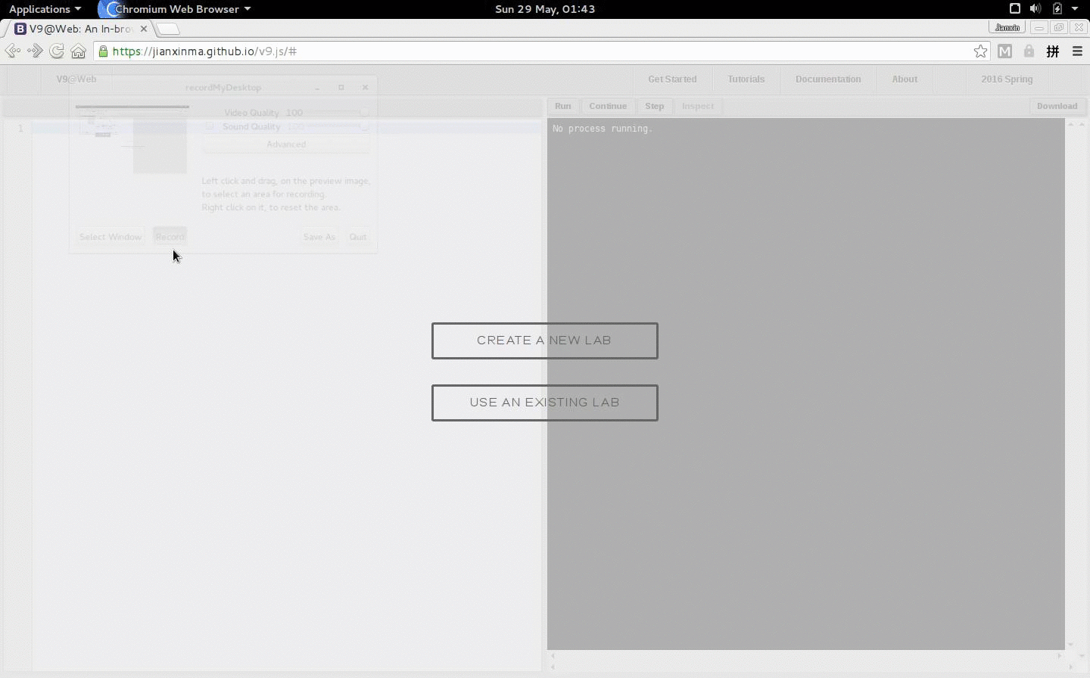
Demo: choose your target lab.

Slide 7
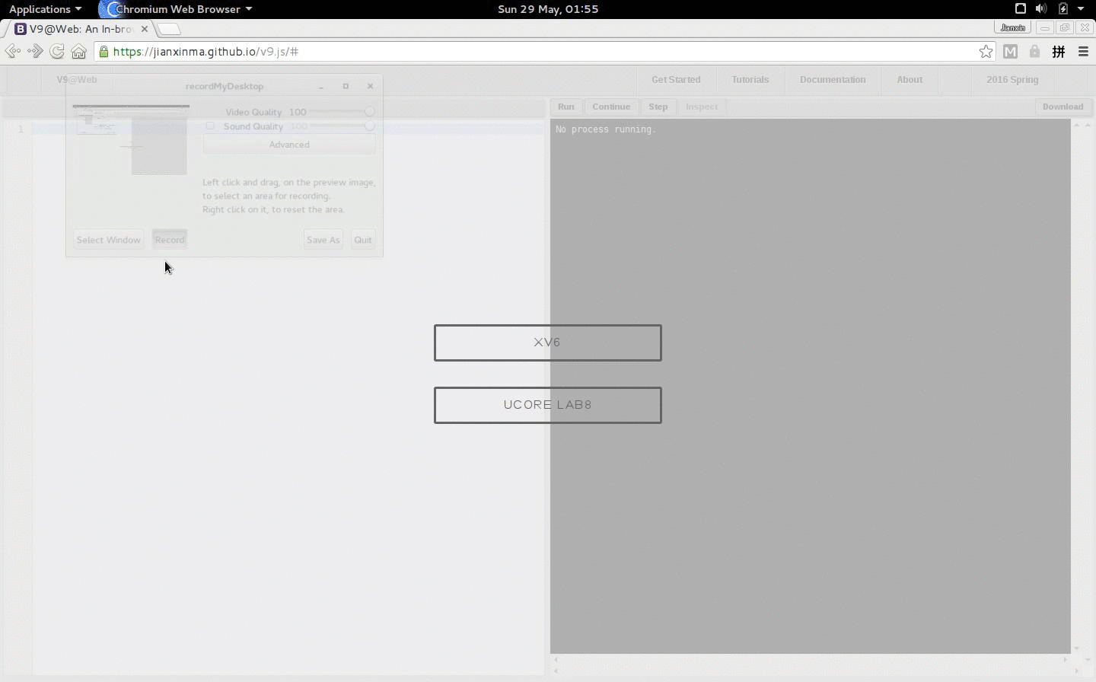
Demo: browse files of your Lab. .

Slide 8
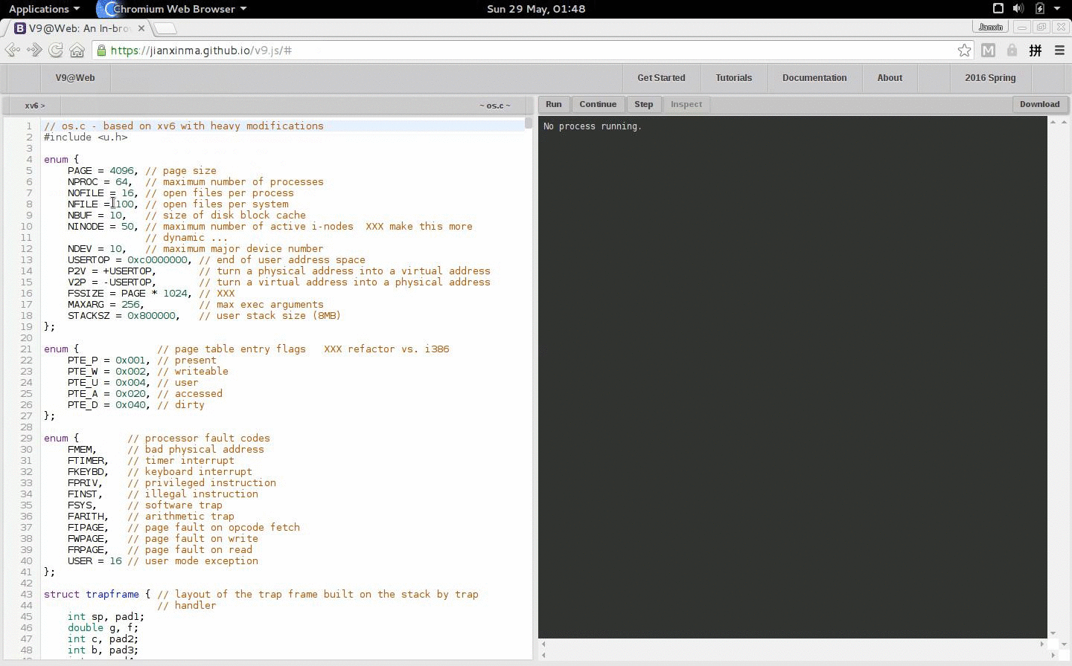
Demo: run your lab - xv6. . .

Slide 9
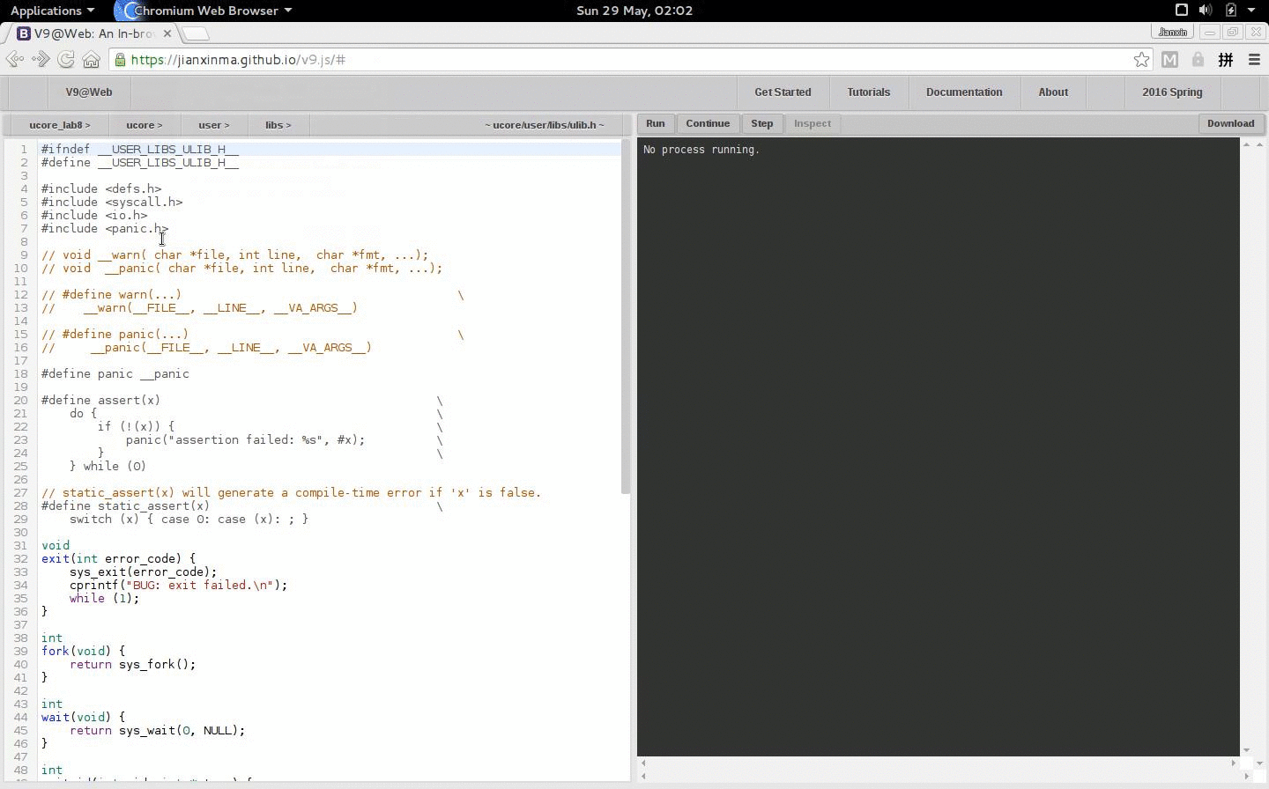
Demo: run your lab - ucore lab8. . .

Slide 10
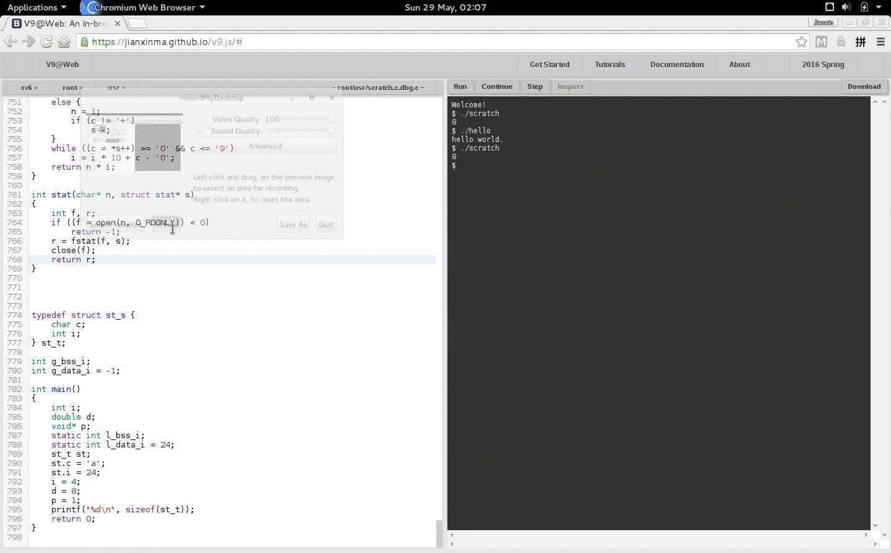
Demo: run your lab until a break point.

Slide 11
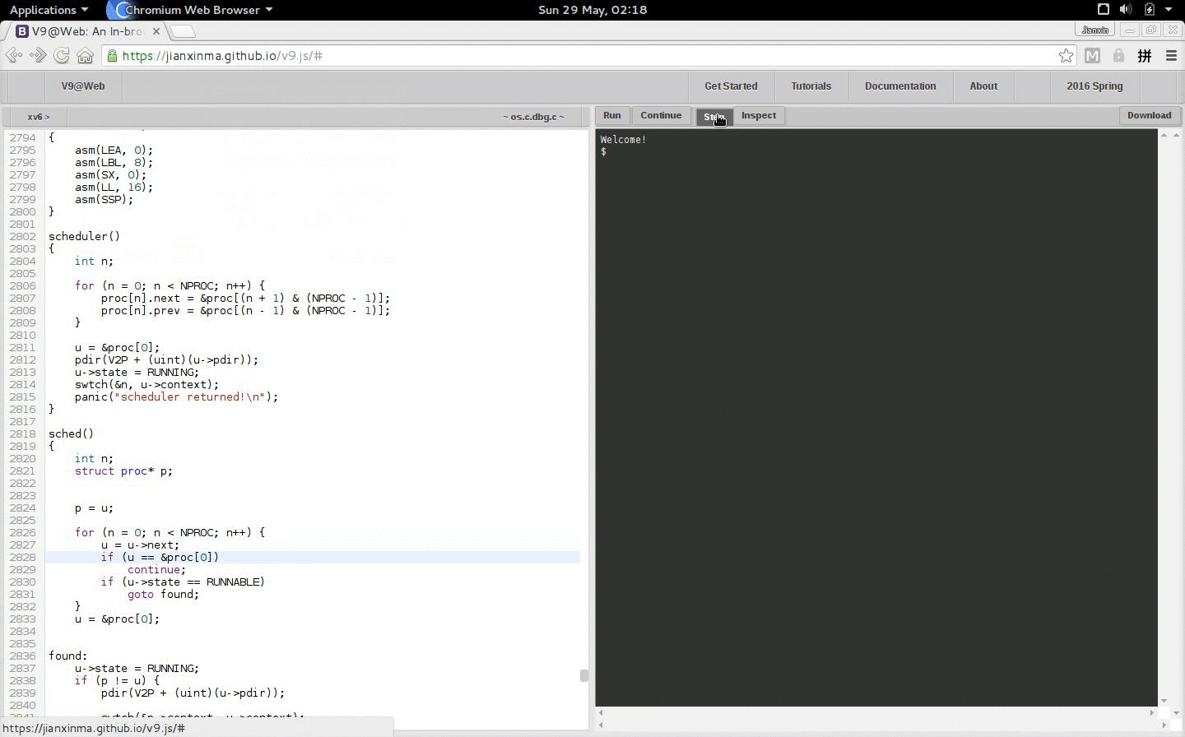
Demo: single step your lab.

Slide 12
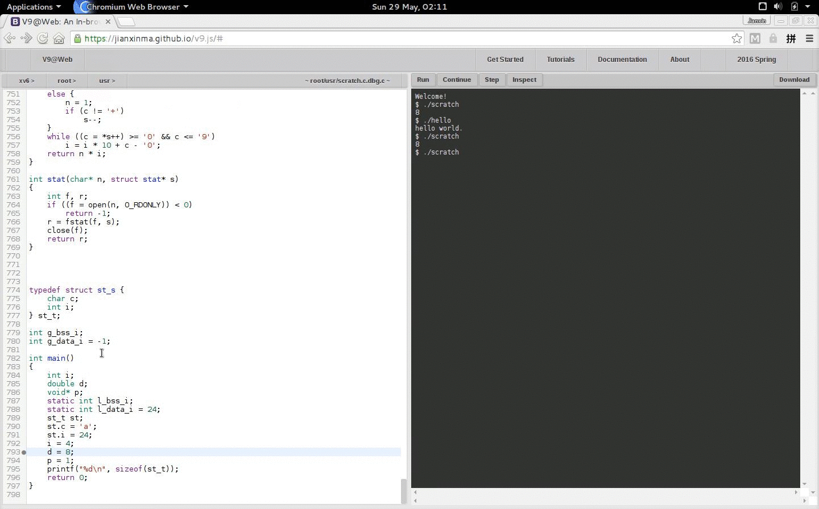
Demo: inspect variable values at runtime.

Slide 13
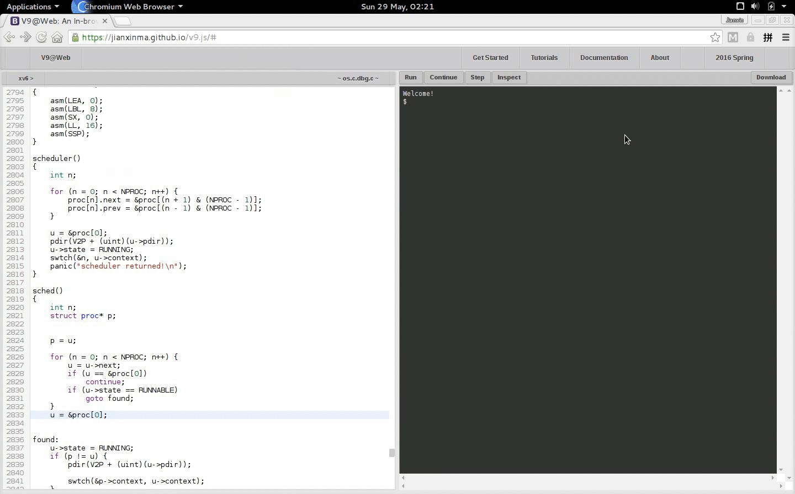
Demo: save all your hard work.

Slide 14
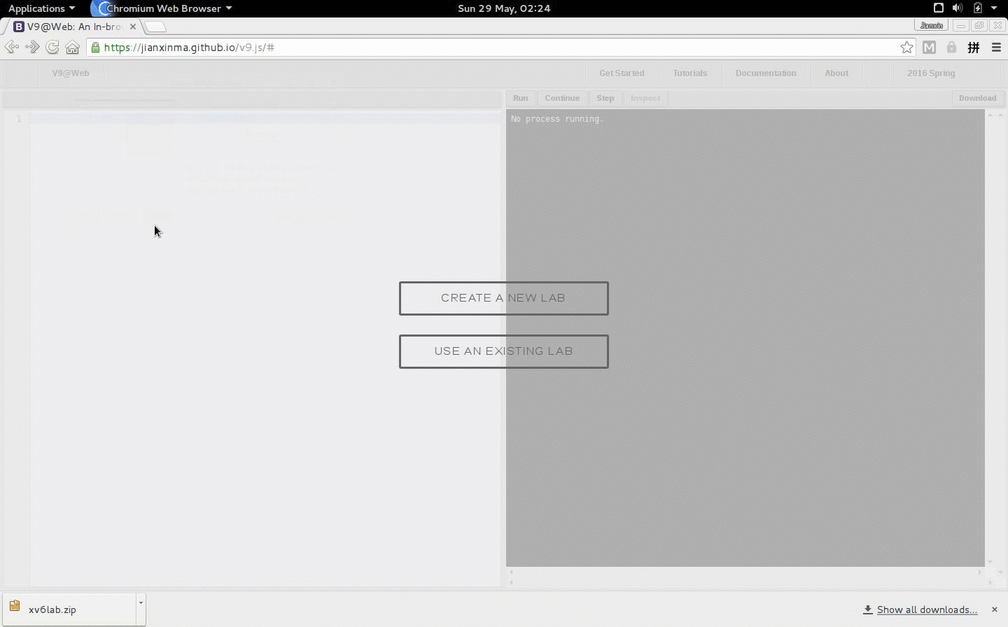
Demo: continue your work next time.

Slide 15
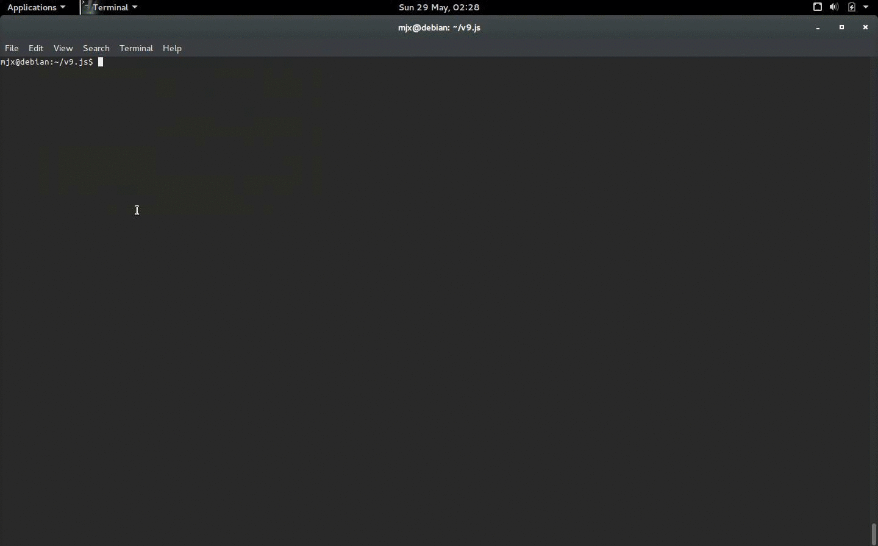
Demo: write a config file for a new lab.

Slide 16
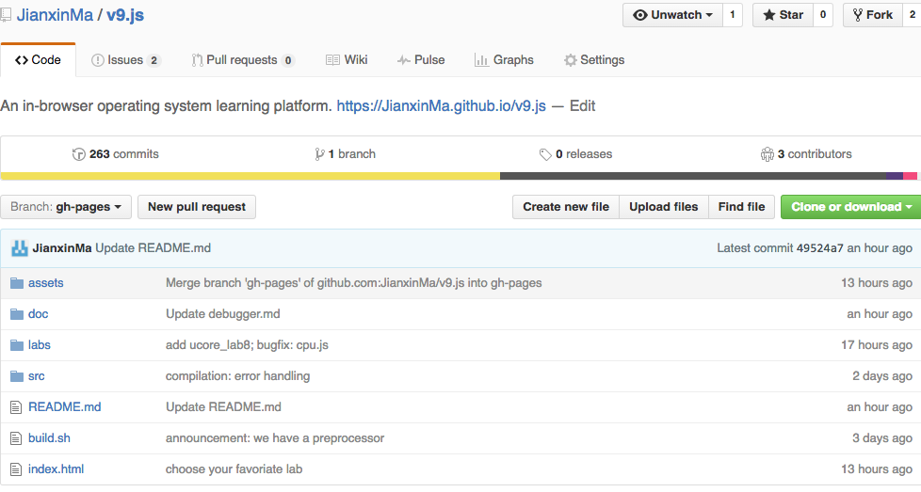
Fork us at GitHub!

Slide 17
Development
How is the simulator implemented?
Manually translated from its C-implemented origin at swieros.
The reason we don't use tools such as Emscripten:
Emscripten-converted code cannot fully interact with users. Though the reason is unclear.
Easier for us to add dubegging support.
Separate instruction-dependent part out----easier to implement new instructions.

Slide 18
Development
How is the debugger implemented?
This is documented in debugger.md.
Some details are also described in my log.

Slide 19
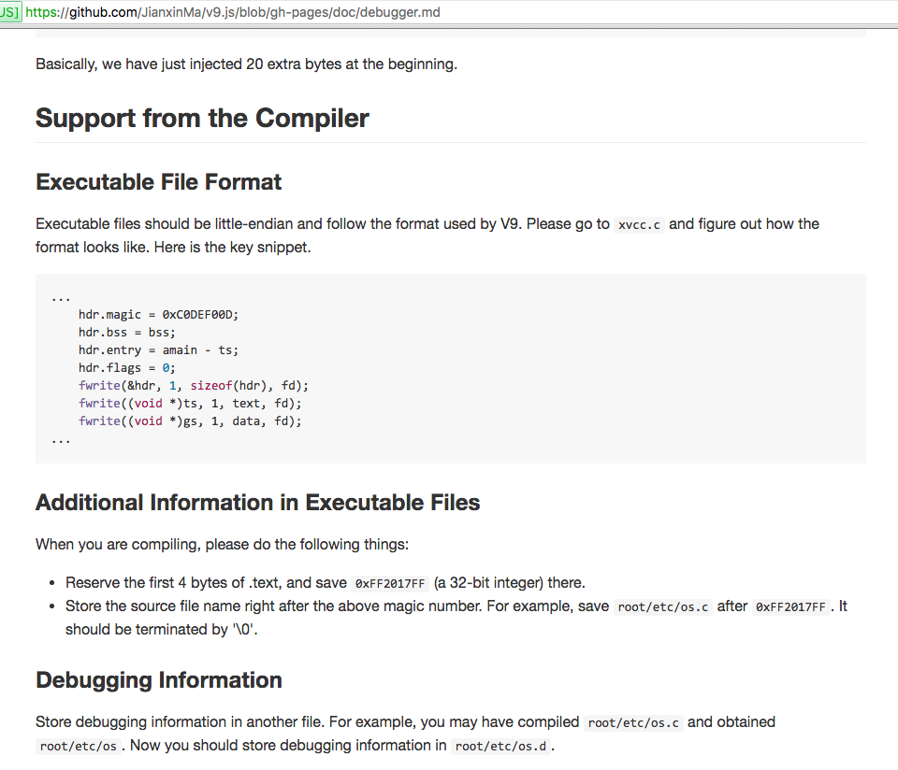
https://github.com/JianxinMa/v9.js/blob/gh-pages/doc/debugger.md

Slide 20
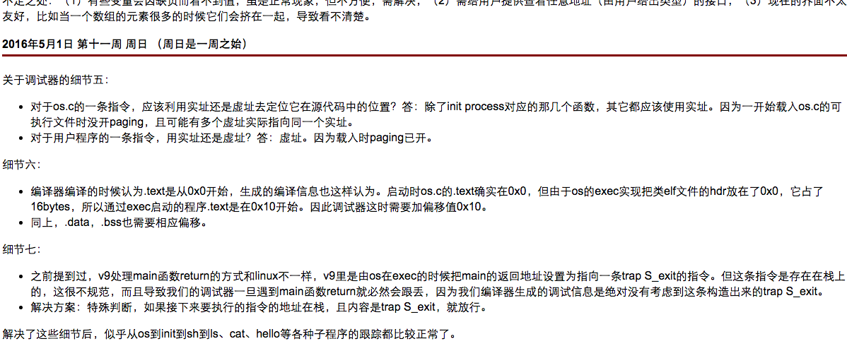
Some of my logs
http://166.111.68.197:11123/oscourse/OS2016spring/projects/u9/emulator

Slide 21
Related Work
The JavaScript-implemented hardware simulator is manually translated from its C-implemented origin at swieros.
The C compiler is also based on that of swieros.
The simplified xv6 operating system is again from swieros.
Emscripten is used for converting the C-implemented C compiler to a JavaScript one.
The C preprocessor is from acgessler.
The ucore operating system is ported by Leonard Xu and Xu Han, see v9-ucore.
In fact, we have a second backend that uses a LLVM-based C compiler. See Alex Wang's work.
For this second backend, a different instruction set and hardware simulator is used. These are done by Paul Zhu.

Slide 22
Future Work
The C Preprocessor
variadic macros, __line__, and __file___ are not supported (working on).
The C Compiler
Error messages are usually quite useless.
Lack support of some ANSI C features.
Although LLVM-based backend can overcome these, it requires much work from a server.
We plan to overcoem these by either:
Improve the existing C compiler.
Or port Tiny C Compiler to our platform, and put it at the front end.
Reliability
Next semester?

